Slide 1
Introduction to MongoDB
Ashley Dunn
Rachel George

Slide 2

What is MongoDB?
Used for high-volume data storage
NoSQL
Stores data in flexible, JSON-like documents

Slide 3
Features
Each database contains collections which in turn contains documents.
Each document can have varying size, content, & number of fields
Document structure more in line with how developers construct their classes and objects in their respective programming languages
No predefined schema
Data model allows you to represent hierarchical relationships, to store arrays, and other more complex structures more easily.
Scalable

Slide 4
Architecture - Key Components
Document - a record in a MongoDB collection, consists of field names and values
Field - name-value pair in a document, similar to columns
Document may have zero or more fields
_id - required field in all documents, similar to a primary key
Automatically created if not specified by user
Collection - grouping of documents, similar to a table
Exists within a single database
Has no enforced structure
Database - container for collections, has set of files on file system
MongoDB server can store multiple databases
Cursor - pointer to result set of query
JSON - JavaScript Object Notation
human readable format to express structured data

Slide 5
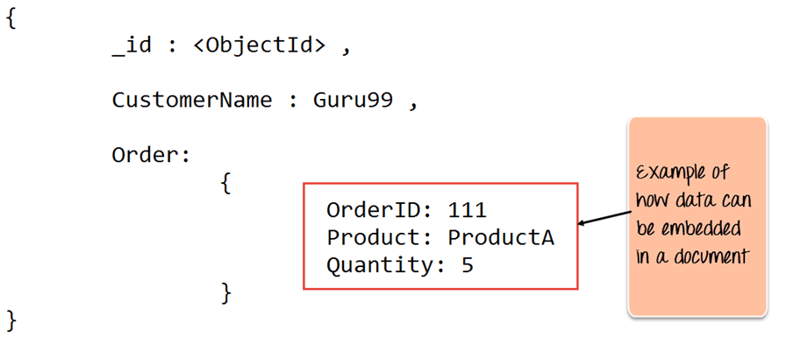
Example
Document
_id field
Embedded Document
Other fields
JSON Format

